Slide 1
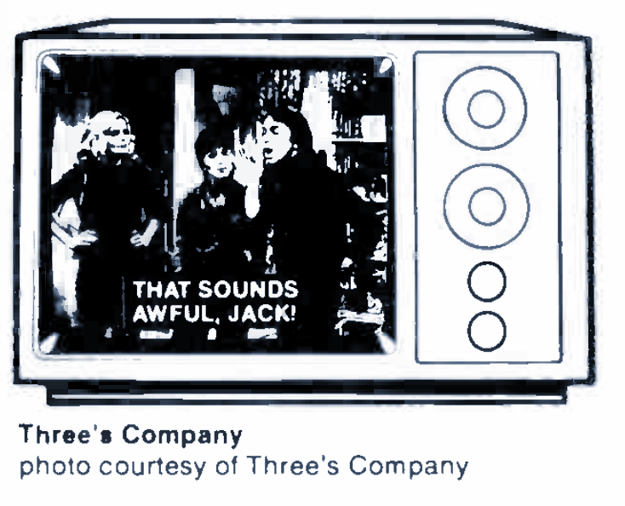
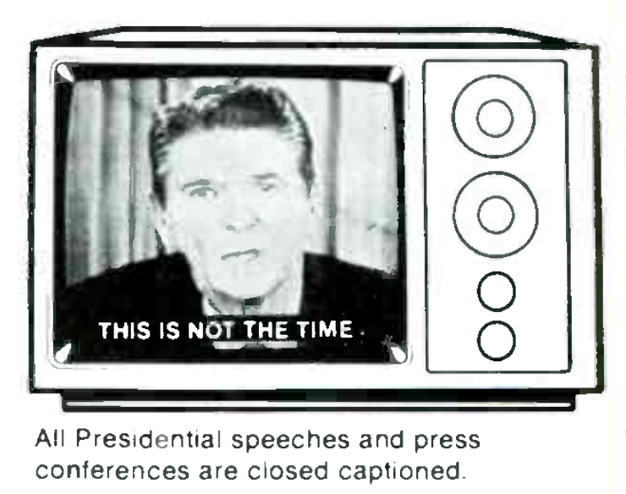
OPENING
CLOSED CAPTIONS
BEN TURKUS AND ANNIE SCHWEIKERT
@bturkus @aeschweik
6 DECEMBER 2019
NO TIME TO WAIT 4

Slide 2
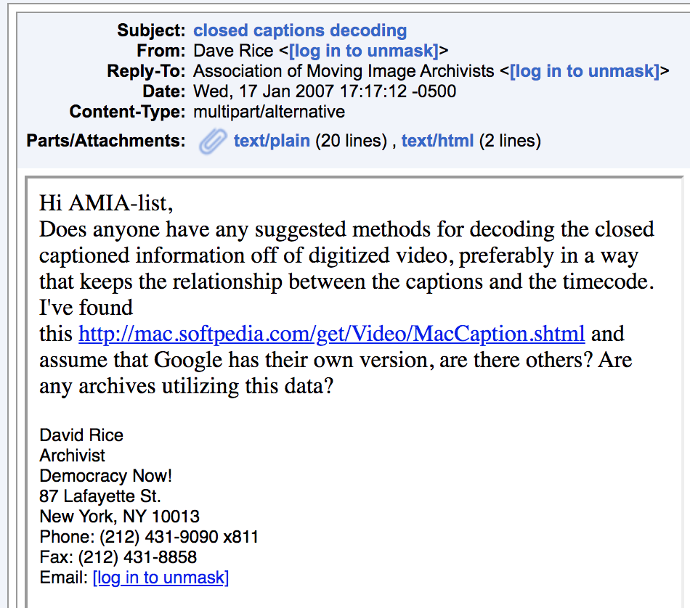
Notes:
ANNIE:
We’ll set the scene with a plea that went out to the AMIA listserv in 2007. “Does anyone have any suggested methods for decoding the closed captioned information off of digitized video, preferably in a way that keeps the relationship between the captions and the timecode? Are any archives utilizing this data?” (For those who can’t read the signature, that was written by David Rice, archivist at Democracy Now.) Dave did not get a lot of responses to his email at the time, but his question was a good one.

Slide 3
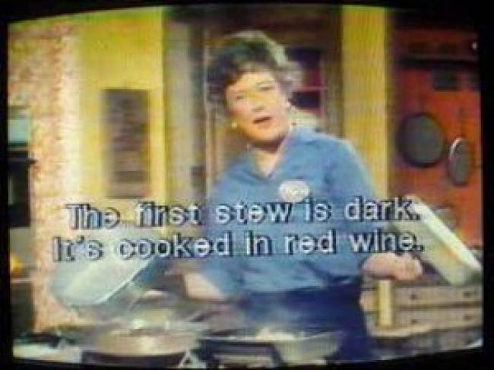
WHY CLOSED CAPTIONS?
The French Chef, WGBH, https://www.wgbh.org/foundation/julia-child
Notes:
ANNIE:
Captions, just to start with a definition, are transcription of dialogue and other audio cues displayed over the image of an audiovisual program. Captions are first and foremost a form of access for Deaf people and others with hearing impairments.
Captions were not a part of the NTSC signal when it was standardized, so they had to be retroactively engineered into broadcast television. These are the first American captions ever broadcast, by WGBH in 1972, on an episode of “The French Chef.” These first captions were “open”—that is, they were burned into the image. Closed captions, which we’ll be talking about, are not part of the image and can be turned on or off by the viewer.

Slide 4
WHY CLOSED CAPTIONS?
Gregory J. Downey, Closed Captioning: Subtitling, Stenography, and the Digital Convergence of Text with Television, 2008, pg. 4
Notes:
ANNIE:
Today, extracting captions from the analog signal and turning them into digital text has a wide range of applications. Accessibility is still primary; extracted captions can be turned into streaming captions for the Web. Extracted captions can also let us do full-text search of television programs or make cataloging easier. If we are able to extract captions, we can build upon decades of labor that often goes unnoticed because it is literally invisible by default.

Slide 5
WHAT MATERIALS HAVE
CLOSED CAPTIONS?
The North American analog caption format is called EIA-608, CEA-608, or “Line 21.” It can be present in:
NTSC broadcast television and home media
ATSC broadcast television
The FCC still requires analog captions in digital broadcasts: “608 over 708”
Not the same, though related:
Teletext (European analog captioning system)
ATSC born-digital captions: EIA-708 or CEA-708
Born-digital captions for streaming media
Notes:
ANNIE:
So, where will you find these captions? First off, you’ll need to have broadcast material or home media from North America. The caption standard we’ll be looking at is called EIA or CEA 608, also known as Line 21, and is supported in both analog NTSC and digital ATSC broadcast standards. This presentation is going to be less relevant to collections with mostly European materials, and I realize we are in Europe so I do apologize for that.

Slide 6
A BRIEF CAPTIONING TIMELINE
1971: Closed captions demonstrated
1972: First open captions broadcast (on PBS/WGBH)
1976: Closed captions approved by FCC
1980: First closed captions for prerecorded media broadcast
1982: First live closed captions broadcast
1990: Television Decoder Circuitry Act
1990: Americans with Disabilities Act
1996: Telecommunications Act
2010: 21st Century Communications and Video Accessibility Act
Notes:
ANNIE:
But if you do have American media in your collection, you’ll start finding closed captions in broadcasts beginning in 1980, with some big jumps in the amount of closed captioning content after legislation in the 1990s. The Television Decoder Circuitry Act of 1990 required new televisions 13 inches or larger to have the built-in ability to decode captions, and the Telecommunications Act of 1996 mandated closed captioning for almost all English and Spanish television programming. Now we’re meeting requirements for closed captions on streaming media as well.

Slide 7
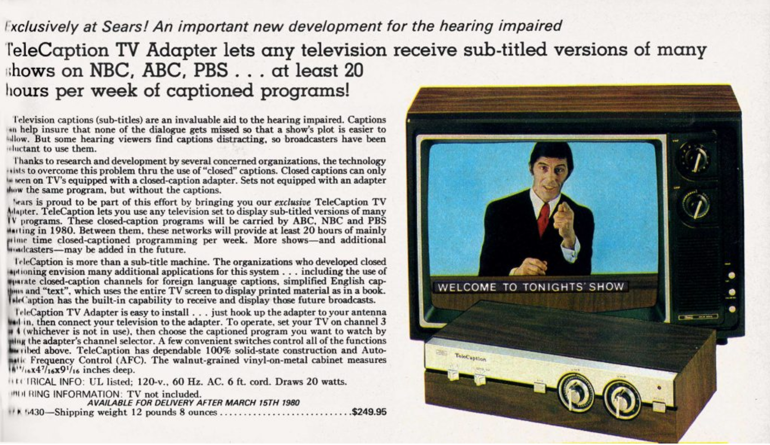
Image: Sears Spring/Summer Catalog, 1980, http://www.thecatalogblog.com/2017/07/20/sears-1980-20-hours-a-week-of-captioned-programs/
Notes:
ANNIE:
Just as an aside, caption adoption did not happen on its own. Initially, captions could not be displayed on a typical television without a separate caption decoder. Here in the 1980 Sears catalog, a decoder retails for $249.96, or about 769 dollars today. This cost barrier meant that ten years after closed captions were first broadcast, it was estimated that only about 2% of Deaf and hearing-impaired people in the US could access these captions. This low rate of accessibility was conveniently perceived as low demand by networks, who then justified less captioning until it was mandated by legislation.

Slide 8
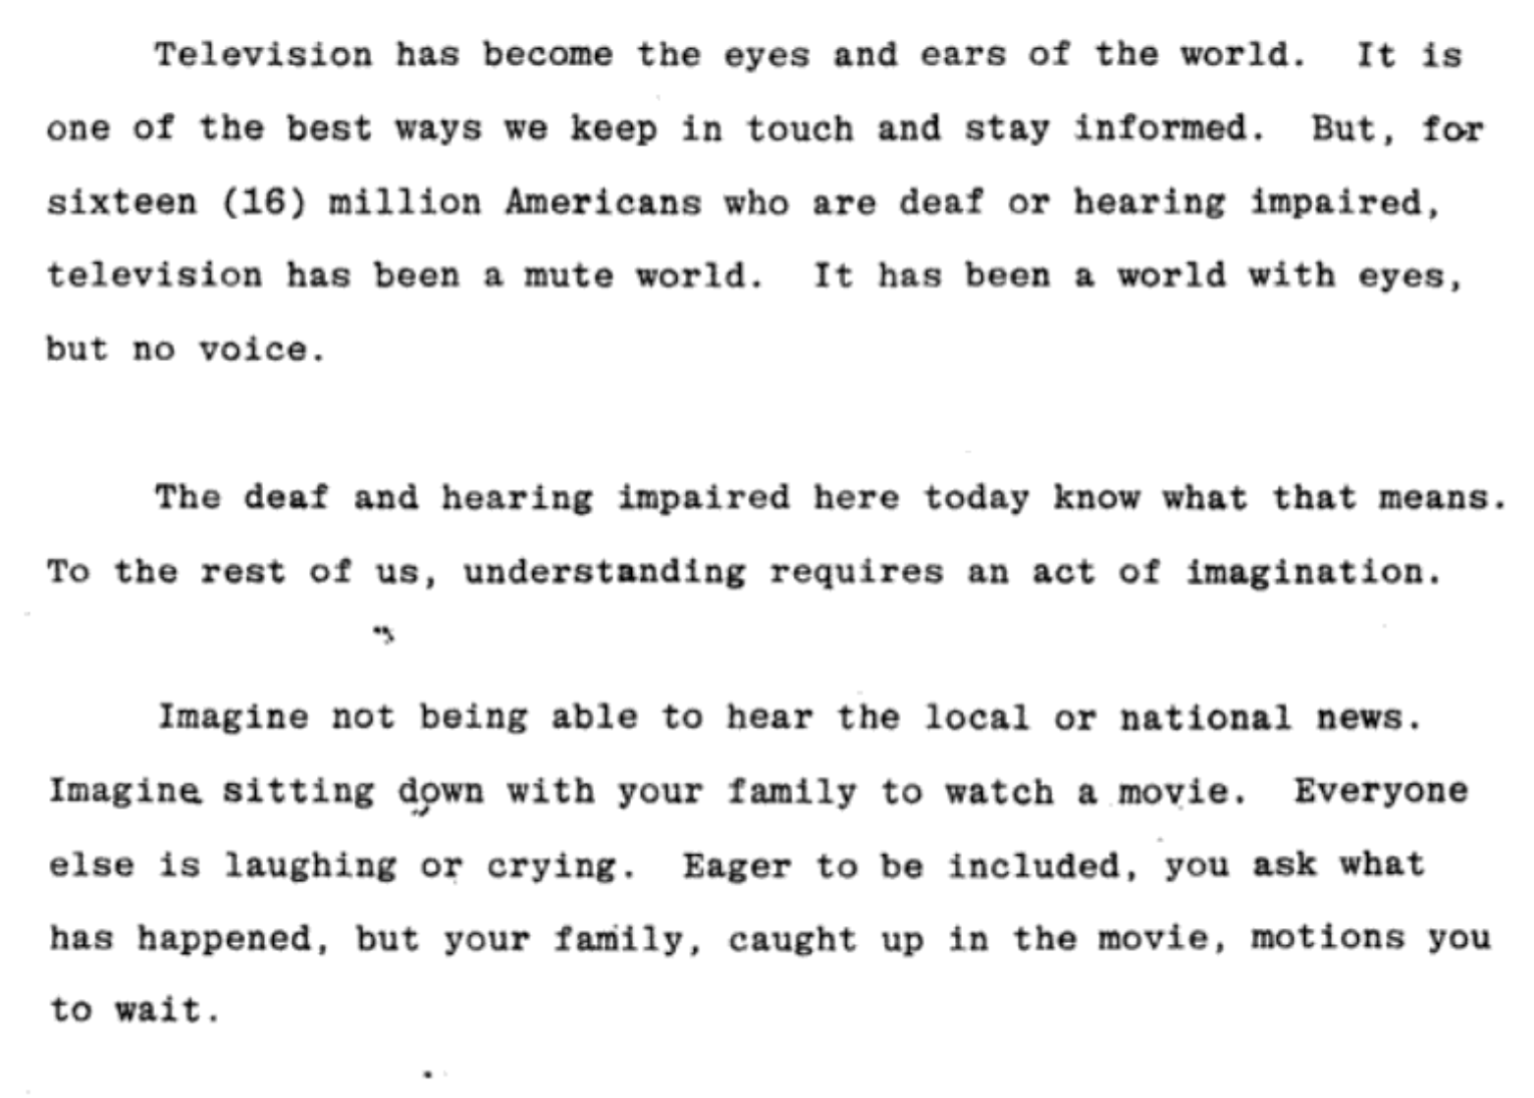
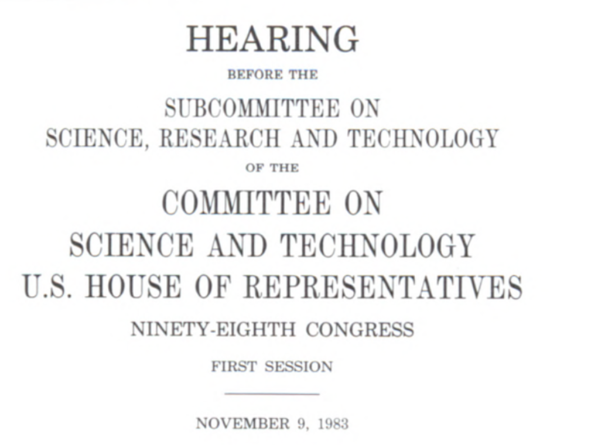
HONORING THE HISTORY OF CC
Notes:
ANNIE:
So figuring out how to extract closed captions is not just saving us time and duplicated effort. It’s also honoring the sustained advocacy that gave us captions. People fought for closed captioning at basically every step, from foundational questions like figuring out a way to add captions to an already-standardized NTSC signal, to passing sweeping federal legislation. So the difficult work of implementing captions has already been done. We just have to figure out how to extract it.
So how do we do that? Where are the closed captions?

Slide 9
Doug Keltz, “Understanding & Troubleshooting Closed Captions,” July 2014, https://www.smpte.org/sites/default/files/section-files/2014_July_Closed_Captioning.pptx
LINE 21
Notes:
ANNIE:
Caption data is transmitted as part of the NTSC vertical blanking interval; that is, they are contained within the lines of video that you usually don’t see on a television. The vertical blanking interval was already used to transmit other metadata, such as timecode, but engineers were able to find space on line 21 of each field, right before the start of the visible image. Each frame of video has two fields, which means two separate sets of captions are transmitted; for example, in the US, field 1 is usually used for English captions and field 2 for Spanish.

Slide 10
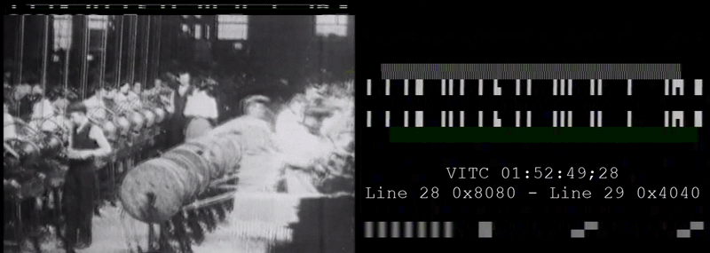
LET’S GET SITUATED
Notes:
ANNIE:
Here’s a gif if you prefer seeing your caption data in action. We can actually see the caption data blinking at the top of this frame on the left, right above the video image; you can see this on a television if you adjust the vertical hold.
Each field of caption data can transmit two bytes at a time. You can see the individual byte pairs flashing by on the right; they’re the hexadecimal characters at the end of the blue arrows.
* Source: https://web.archive.org/web/20070630102608/http://www.robson.org/capfaq/technical.html

Slide 11
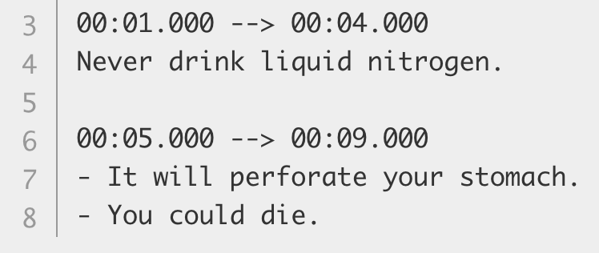
EXTRACTED CAPTION FORMATS
SCC - recommended by many streaming services
WebVTT
TTML
SRT
Notes:
ANNIE:
Caption data can be extracted straight to a formatted text file. SCC, one of the simplest digital caption file formats, just records the raw caption hexadecimal alongside timecodes. Other caption formats use a translation matrix to turn the hex into simple human-readable captions, such as in the SRT and WebVTT formats. Timed Text Markup Language, is an example of a more heavily structured format used primarily in broadcast production environments. Each of these caption formats can be used for digital delivery, and all are compatible with each other. Many streaming services accept any of these caption formats.

Slide 12
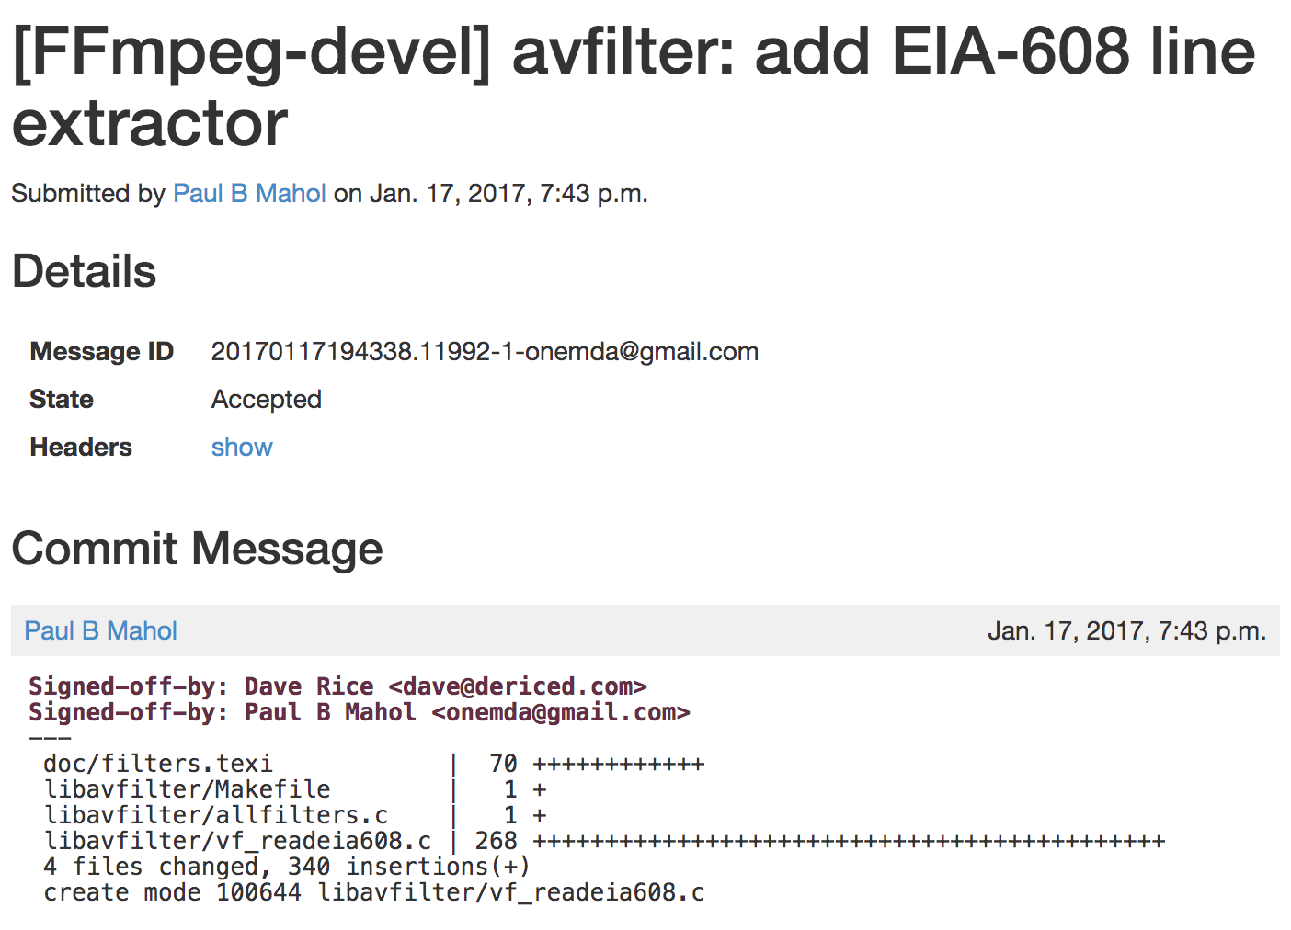
https://patchwork.ffmpeg.org/patch/2235/
Notes:
There are a number of methods of extracting the caption data from the analog signal, but the one we’ll be focusing on today is FFmpeg’s filter to extract EIA608, or line 21, captions, authored by Paul B Mahol in 2017. This filter scans the field for EIA-608 data and associates it with timecode. I am not qualified to talk about how it actually works, but I do want to say thank you to Paul for your work in making this filter!
So, now we know where to find the captions, we have an open source way to extract them, and we know what we want them to look like once extracted...

Slide 13
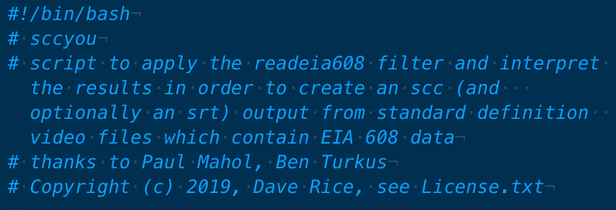
github.com/amiaopensource/sccyou
Notes:
ANNIE:
All it takes is a script. This script is SCCYOU, which is available on GitHub, and which was written this year by Dave Rice using Paul Mahol’s filter. It can locate closed caption data in your files and translate it into SCC and SRT captions. To talk much more about it, the always-delightful Ben Turkus!

Slide 14
sccyou
YOU SHOULD’VE ALREADY EXISTED
vertical bbbbblanking interval
open source sponsorship in action
a free and open solution
Notes:
BEN

Slide 15
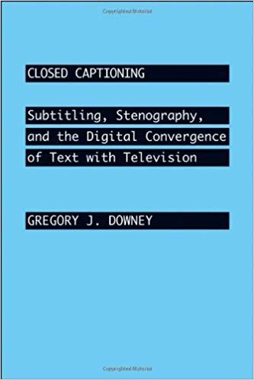
THE “VISIBILITY PARADOX” OF CLOSED CAPTIONING
A simple right of media participation long denied
“The very design of captioned text to be ‘closed’ instead of ‘open’—that is, ever-present in the broadcast signal but invisible on the screen until the feature is turned on by the user—was meant to keep it out of sight of hearing television viewers” (4).
Notes:
BEN

Slide 16
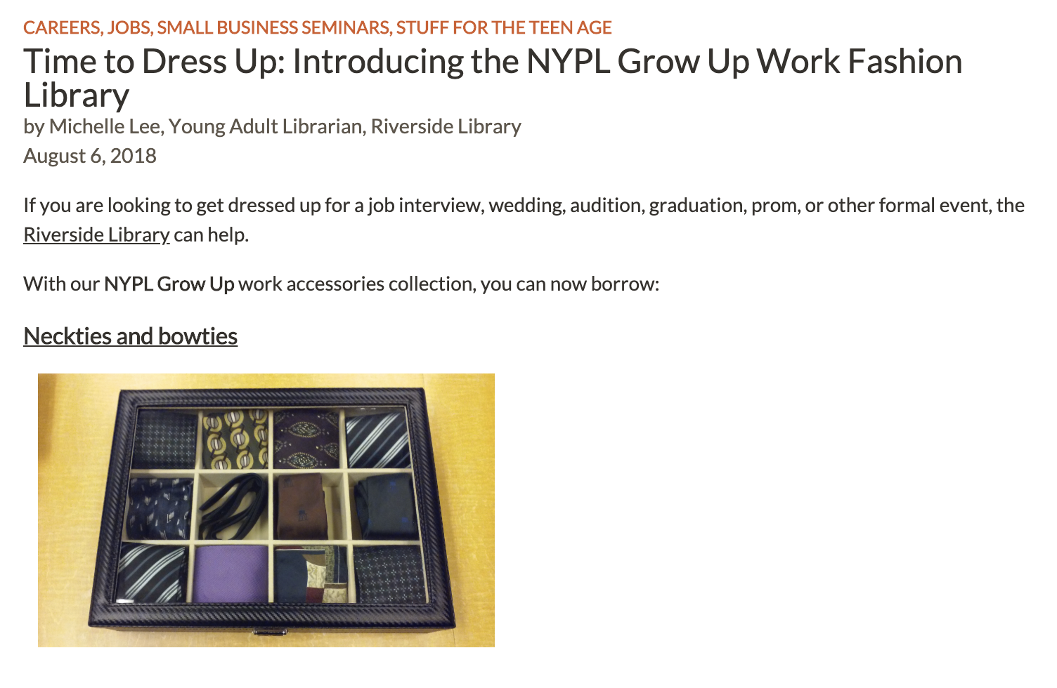
NYPL INNOVATION PROJECT
“MORE PEOPLE READING MORE...CAPTIONS”
Notes:
BEN

Slide 17
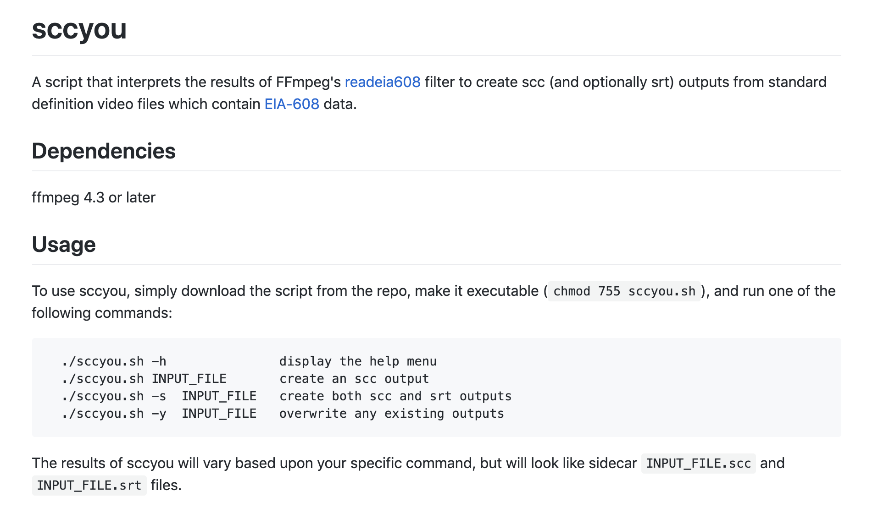
WHERE IS SCCYOU? HOW’S IT WORK?
www.github.com/amiaopensource/sccyou
Notes:
BEN

Slide 18
WHAT’S GOING ON UNDER THE HOOD?
www.github.com/amiaopensource/sccyou
Notes:
BEN

Slide 19
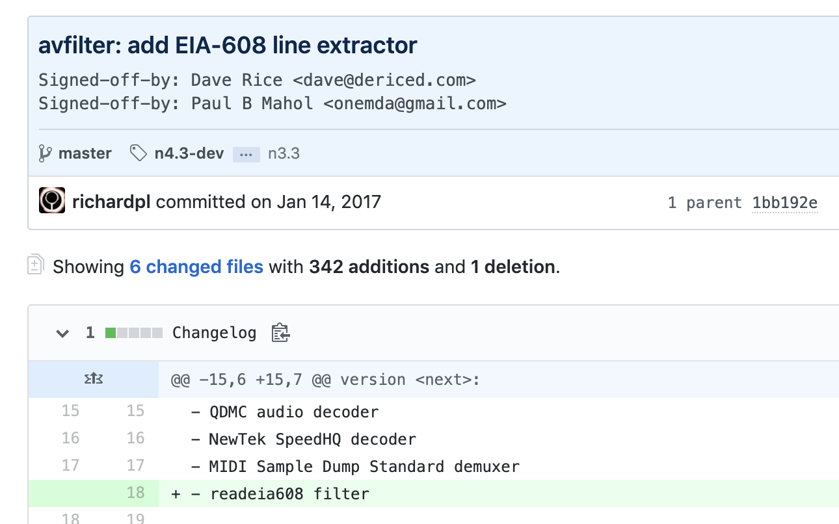
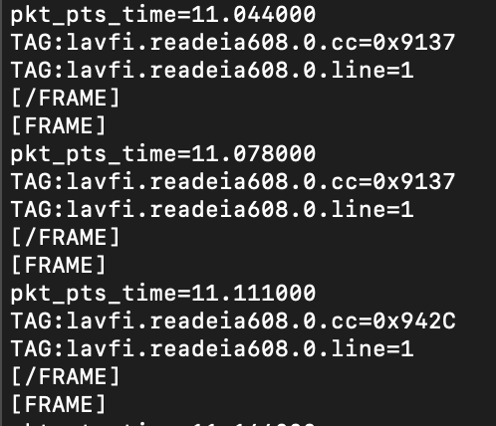
WHAT’S GOING ON UNDER THE HOOD?
www.github.com/amiaopensource/sccyou
Notes:
BEN

Slide 20
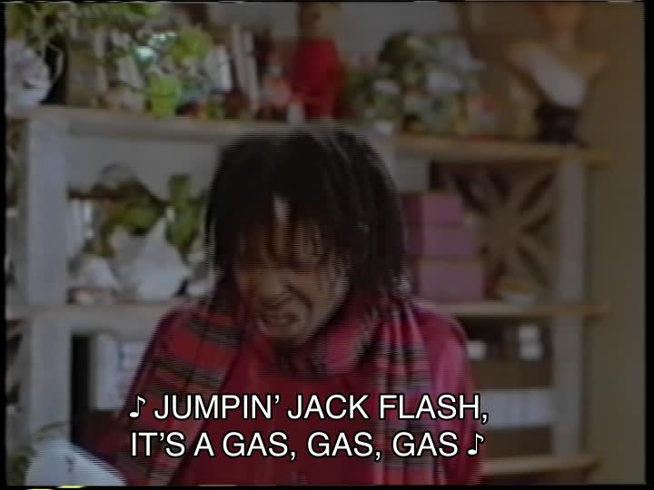
WHAT’S GOING ON UNDER THE HOOD?
Notes:
BEN

Slide 21
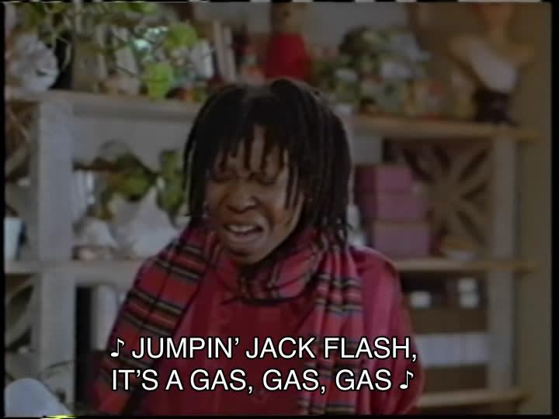
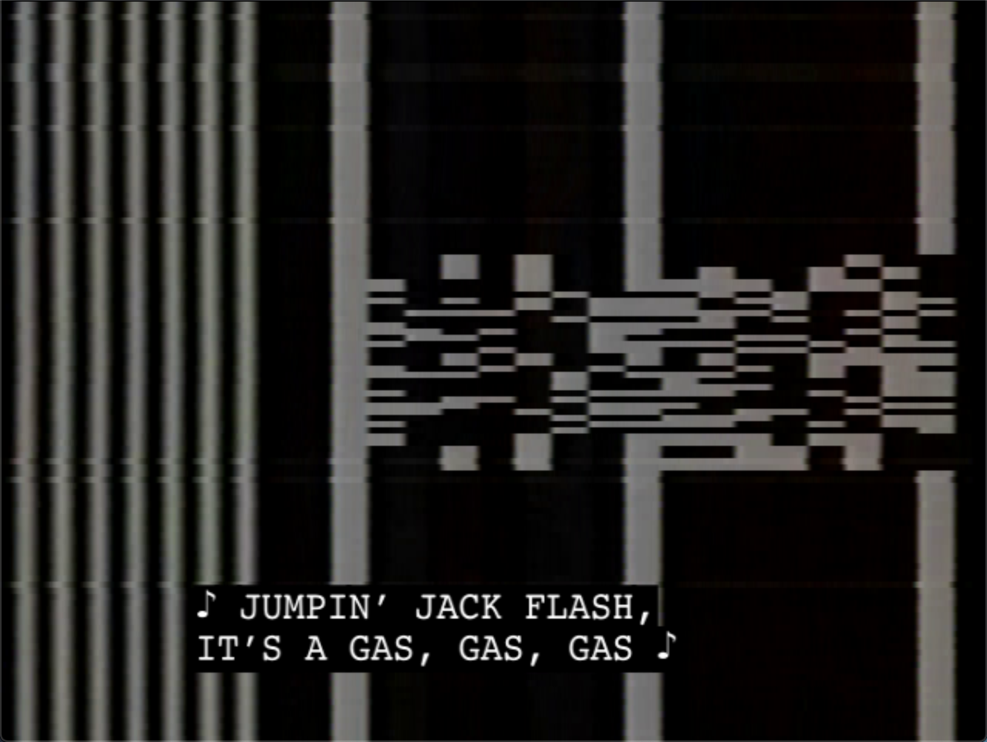
PLAYBACK PREVIEW IN TWO FORMS
Notes:
BEN

Slide 22
#trashcaptions
“Information on line 21, but not CC”
Notes:
BEN

Slide 23
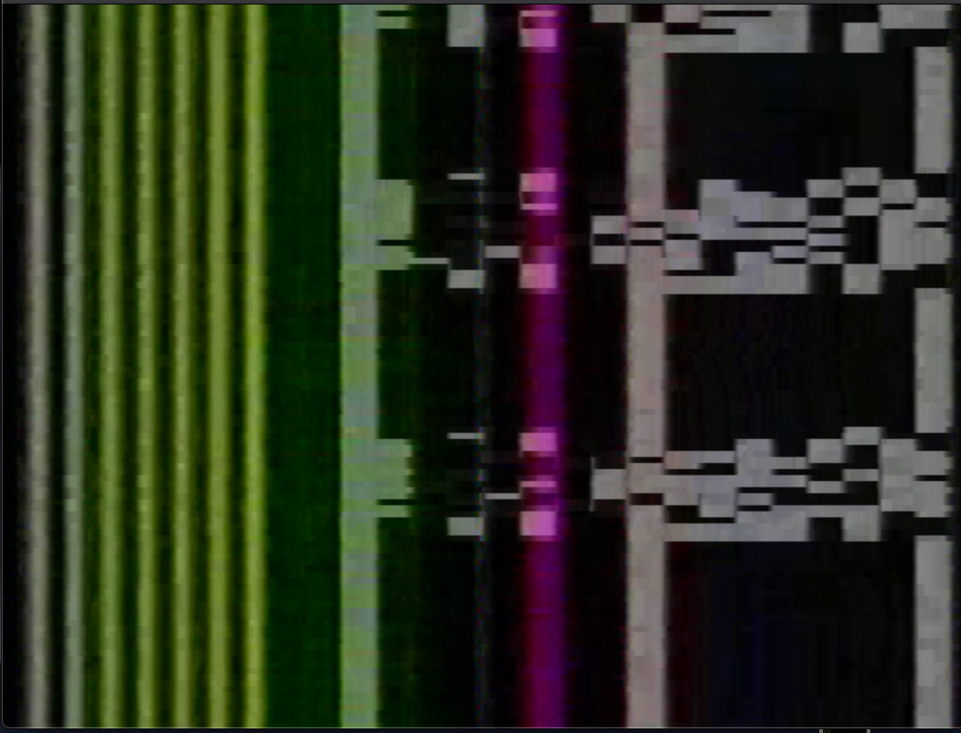
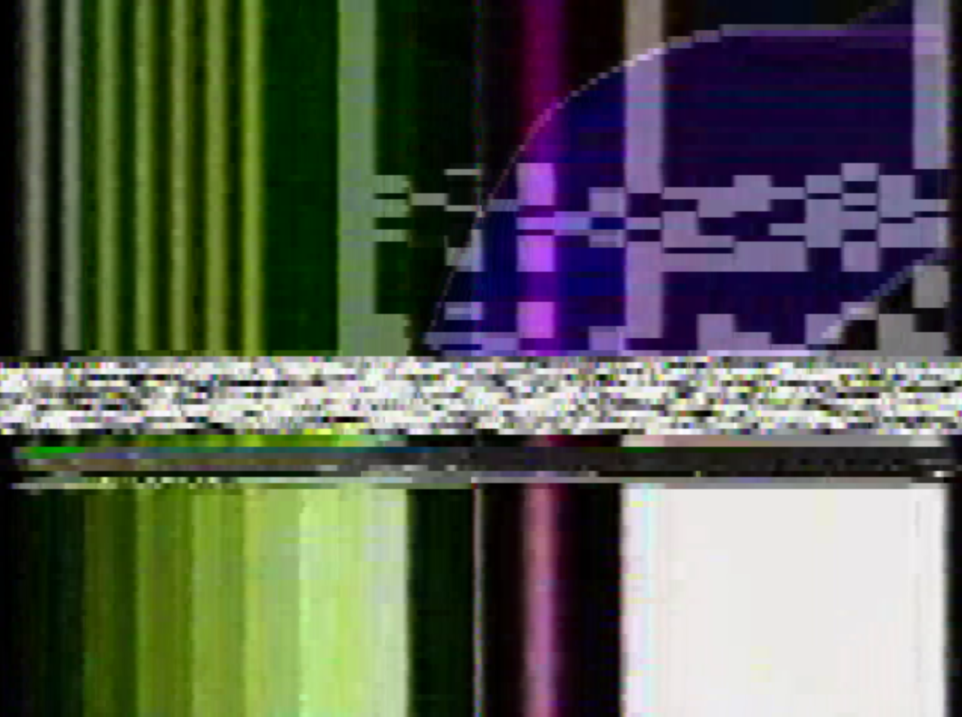
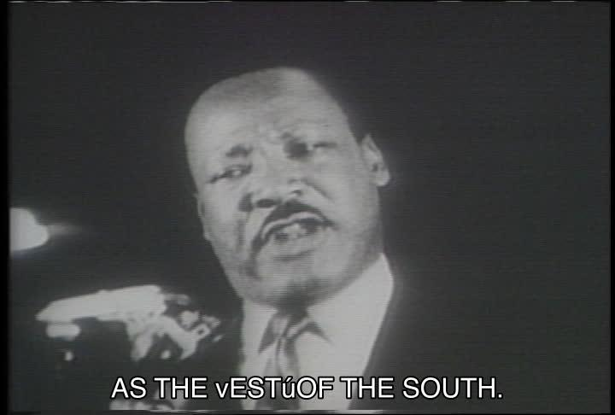
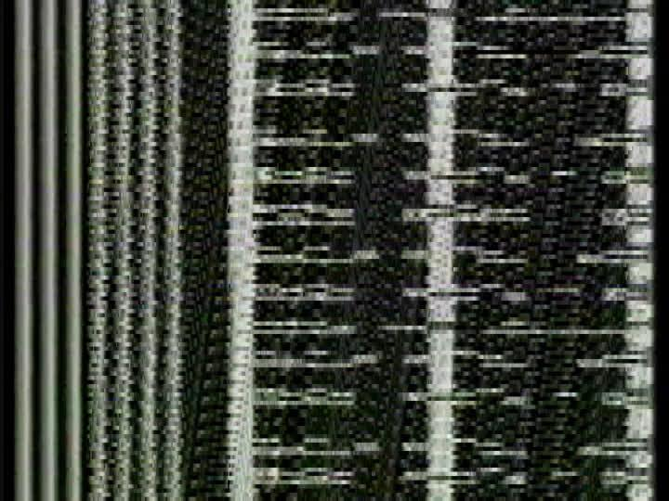
#trashcaptions
Notes:
BEN

Slide 24
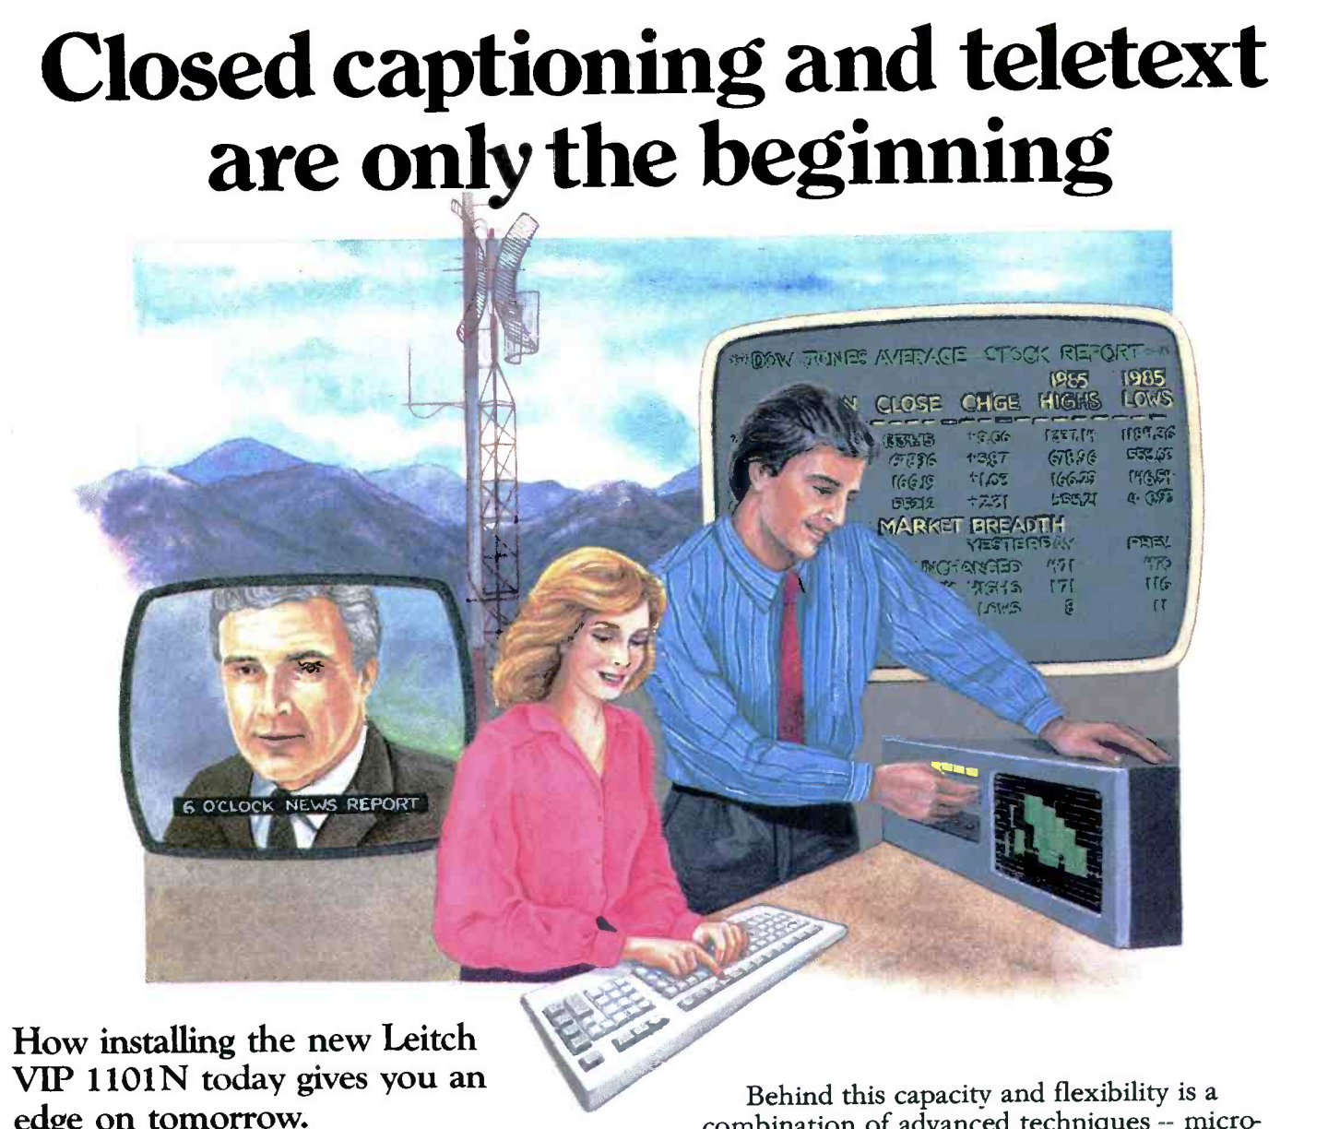
WHAT’S NEXT?
Incorporation into vrecord
Handling of multiple caption tracks (odds and evens, English and SAP)
Refinement of testing for presence of captions (beginning, middle, and end)
Development of quality control procedures for closed captioning
Better reporting on trash captions
Notes:
BEN

